Slide 1
Gene Transfer
Genetic recombination - transfer of DNA from one organism (donor) to another recipient. The transferred donor DNA may then be integrated into the recipient's nucleoid by various mechanisms (homologous, non-homologous).
Homologous recombination- homologous DNA sequences having nearly the same nucleotide sequences are exchanged by means of Rec A proteins. This involves breakage and reunion of paired DNA segments as seen in natural mechanisms of genetic recombination in bacteria include:
a. transformation b. transduction c. conjugation

Slide 2
Mechanism of Gene transfer
DNA can be transferred from one organism to another, and that
DNA can be stably incorporated in the recipient, permanently
changing its genetic composition. This process is called
lateral or horizontal gene transfer to differentiate it from the
inheritance of parental genes, a process called vertical
inheritance.
There are 3broad mechanisms mediate efficient movement of DNA
between cells:
- conjugation,
- transduction,
- transformation.

Slide 3
Bacterial Conjugation
Bacterial Conjugation is genetic recombination in which there is a transfer of DNA from a living donor bacterium to a recipient bacterium. Often involves a sex pilus.
The 3 conjugative processes
I. F⁺ conjugation
II. Hfr conjugation
III. Resistance plasmid conjugation

Slide 4
I. F+ Conjugation Process
F+ Conjugation- Genetic recombination in which there is a transfer of an F+ plasmid (coding only for a sex pilus) but not chromosomal DNA from a male donor bacterium to a female recipient bacterium. Involves a sex (conjugation) pilus. Other plasmids present in the cytoplasm of the bacterium, such as those coding for antibiotic resistance, may also be transferred during this process.

Slide 5
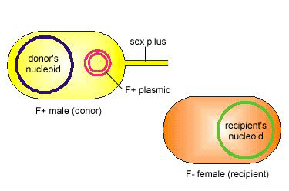
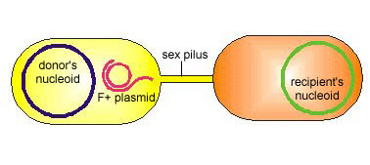
The 4 stepped F+ Conjugation
1. The F+ male has an F+ plasmid coding for a sex pilus and can serve as a genetic donor
2. The sex pilus adheres to an F- female (recipient). One strand of the F+ plasmid breaks

Slide 6
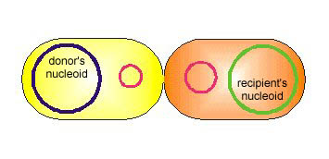
The 4 stepped F+ Conjugation (cont’d)
3. The sex pilus retracts and a bridge is created between the two bacteria. One strand of the F+ plasmid enters the recipient bacterium
4. Both bacteria make a complementary strand of the F+ plasmid and both are now F+ males capable of producing a sex pilus. There was no transfer of donor chromosomal DNA although other plasmids the donor bacterium carries may also be transferred during F+ conjugation.
http://www.cat.cc.md.us/courses/bio141/lecguide/unit4/genetics/recombination/conjugation/f.htm l

Slide 7
II. Hfr Conjugation
Genetic recombination in which fragments of chromosomal DNA from a male donor bacterium are transferred to a female recipient bacterium following insertion of an F+ plasmid into the nucleoid of the donor bacterium. Involves a sex (conjugation)pilus.

Slide 8
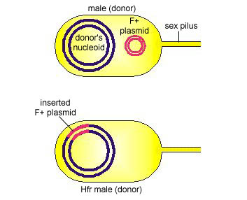
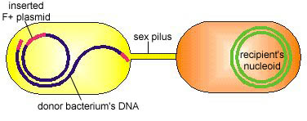
5 stepped Hfr Conjugation
1. An F+ plasmid inserts into the donor bacterium's nucleoid to form an Hfr male.
2. The sex pilus adheres to an F- female (recipient). One donor DNA strand breaks in the middle of the inserted F+ plasmid.

Slide 9
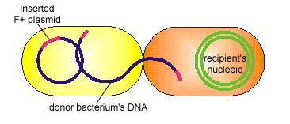
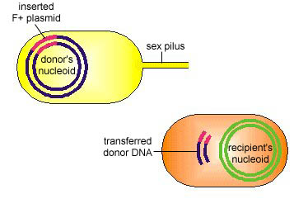
5 stepped Hfr Conjugation (cont’d)
3. The sex pilus retracts and a bridge forms between the two bacteria. One donor DNA strand begins to enter the recipient bacterium. The two cells break apart easily so the only a portion of the donor's DNA strand is usually transferred to the recipient bacterium.
4. The donor bacterium makes a complementary copy of the remaining DNA strand and remains an Hfr male. The recipient bacterium makes a complementary strand of the transferred donor DNA.

Slide 10
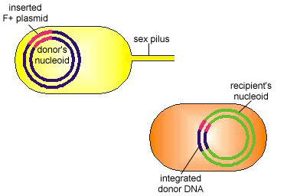
5 stepped Hfr Conjugation (cont’d)
5. The donor DNA fragment undergoes genetic exchange with the recipient bacterium's DNA. Since there was transfer of some donor chromosomal DNA but usually not a complete F+ plasmid, the recipient bacterium usually remains F-
http://www.cat.cc.md.us/courses/bio141/lecguide/unit4/genetics/recombination/conjugation/hfr.htm l

Slide 11
III. Resistant Plasmid Conjugation
Genetic recombination in which there is a transfer of an R plasmid (a plasmid coding for multiple antibiotic resistance and often a sex pilus) from a male donor bacterium to a female recipient bacterium. Involves a sex (conjugation) pilus

Slide 12
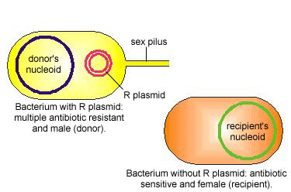
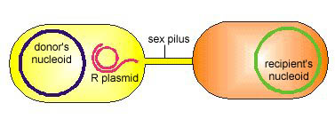
4 steped Resistant Plasmid Conjugation
1. The bacterium with an R-plasmid is multiple antibiotic resistant and can produce a sex pilus (serve as a genetic donor).
2. The sex pilus adheres to an F- female (recipient). One strand of the R-plasmid breaks.

Slide 13
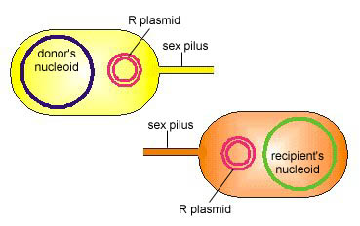
4 stepped Resistant Plasmid Conjugation (cont’d)
3. The sex pilus retracts and a bridge is created between the two bacteria. One strand of the R-plasmid enters the recipient bacterium.
4. Both bacteria make a complementary strand of the R-plasmid and both are now multiple antibiotic resistant and capable of producing a sex pilus.
http://www.cat.cc.md.us/courses/bio141/lecguide/unit4/genetics/recombination/conjugation/r.html

Slide 14
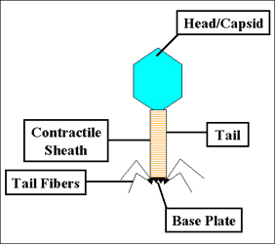
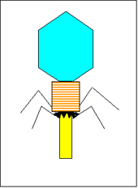
Transduction
Genetic recombination in which a DNA fragment is transferred from one bacterium to another by a bacteriophage
Structure of T4 bacteriophage
Contraction of the tail sheath of T4

Slide 15
What are Bacteriophages?
Bacteriophage (phage) are obligate intracellular parasites that multiply inside bacteria by making use of some or all of the host biosynthetic machinery (i.e., viruses that infect bacteria

Slide 16
Transduction (cont’d)
There are two types of transduction:
generalized transduction: A DNA fragment is transferred from one bacterium to another by a lytic bacteriophage that is now carrying donor bacterial DNA due to an error in maturation during the lytic life cycle.
specialized transduction: A DNA fragment is transferred from one bacterium to another by a temperate bacteriophage that is now carrying donor bacterial DNA due to an error in spontaneous induction during the lysogenic life cycle

Slide 17
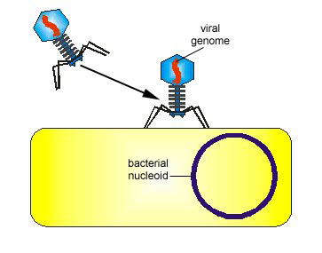
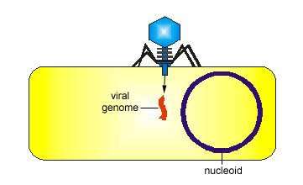
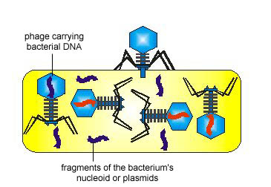
Seven steps in Generalised Transduction
A lytic bacteriophage adsorbs to a susceptible
bacterium.
2. The bacteriophage genome enters the bacterium. The genome directs the bacterium's metabolic machinery to manufacture bacteriophage components and enzymes
3. Occasionally, a bacteriophage head or capsid assembles around a fragment of donor bacterium's nucleoid or around a plasmid instead of a phage genome by mistake.

Slide 18
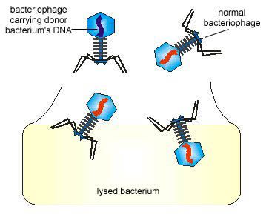
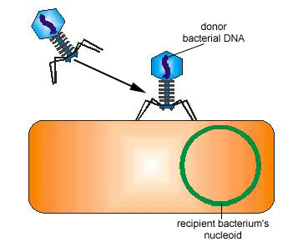
Seven steps in Generalised Transduction (cont’d)
4. The bacteriophages are released.
5. The bacteriophage carrying the donor bacterium's DNA adsorbs to a recipient bacterium

Slide 19
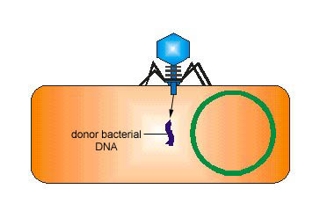
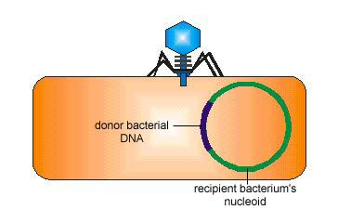
Seven steps in Generalised Transduction (contd)
6. The bacteriophage inserts the donor bacterium's DNA it is carrying into the recipient bacterium .
7. The donor bacterium's DNA is exchanged for some of the recipient's DNA.
http://www.cat.cc.md.us/courses/bio141/lecguide/unit4/genetics/recombination/transduction/transduction.html

Slide 20
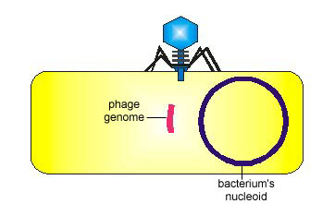
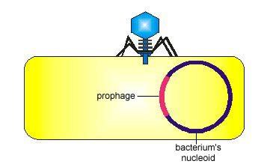
Six steps in Specialised Transduction
1. A temperate bacteriophage adsorbs to a susceptible bacterium and injects its genome .
2. The bacteriophage inserts its genome into the bacterium's nucleoid to become a prophage.

Slide 21
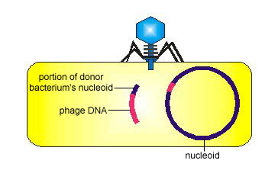
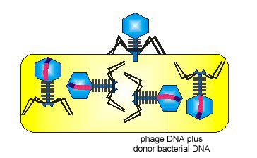
Six steps in Specialised Transduction (cont’d)
3. Occasionally during spontaneous induction, a small piece of the donor bacterium's DNA is picked up as part of the phage's genome in place of some of the phage DNA which remains in the bacterium's nucleoid.
4. As the bacteriophage replicates, the segment of bacterial DNA replicates as part of the phage's genome. Every phage now carries that segment of bacterial DNA.

Slide 22
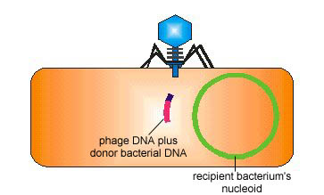
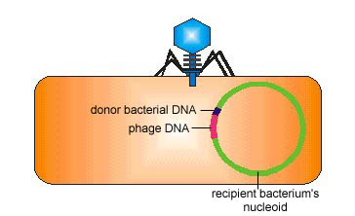
Six steps in Specialised Transduction (cont’d)
5. The bacteriophage adsorbs to a recipient bacterium and injects its genome.
6. The bacteriophage genome carrying the donor bacterial DNA inserts into the recipient bacterium's nucleoid.
http://www.cat.cc.md.us/courses/bio141/lecguide/unit4/genetics/recombination/transduction/spectran.html

Slide 24
Transformation
Genetic recombination in which a DNA fragment from a dead, degraded bacterium enters a competent recipient bacterium and it is exchanged for a piece of the recipient's DNA.
Involves 4 steps

Slide 25
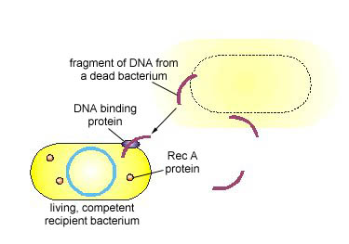
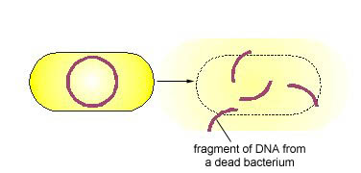
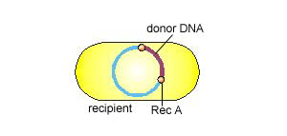
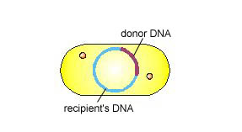
The 4 steps in Transformation
1. A donor bacterium dies and is degraded
2. A fragment of DNA from the dead donor bacterium binds to DNA binding proteins on the cell wall of a competent, living recipient bacterium
3. The Rec A protein promotes genetic exchange between a fragment of the donor's DNA and the recipient's DNA
4. Exchange is complete

Slide 26
Other genetic elements
Transposon (Jumping Gene): are mobile genetic elements that can
transfer DNA within a cell , from one position to another in the
genome, or between different molecules of DNA. The simplest
one called Insertion sequences
Pathogenicty Islands: are mobile genetic elements may range
from 10-200 kb and encode genes which contribute to the
virulence of the respective pathogen.
1. have a different G + C content from the rest of the genome
2. are closely linked on the chromosome to tRNA genes
3. are flanked by direct repeats
4. contain diverse genes important for pathogenesis—including
adhesins, invasins, and exotoxins

Slide 27
Bacteria often respond to environmental change by regulating transcription
Natural selection has favored bacteria that produce only the products needed by that cell
A cell can regulate the production of enzymes by feedback inhibition or by gene regulation
Gene expression in bacteria is controlled by the operon model
© 2011 Pearson Education, Inc.

Slide 28
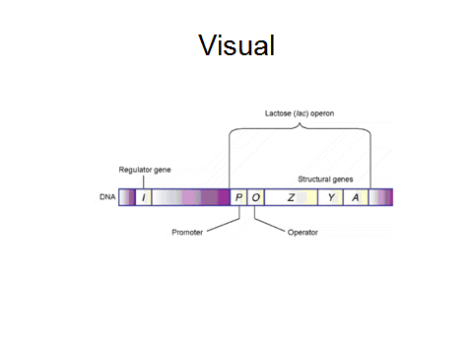

Slide 29
Operons: The Basic Concept
A cluster of functionally related genes can be under coordinated control by a single “on-off switch”
The regulatory “switch” is a segment of DNA called an operator usually positioned within the promoter
An operon is the entire stretch of DNA that includes the operator, the promoter, and the genes that they control
© 2011 Pearson Education, Inc.

Slide 30
The operon can be switched off by a protein repressor
The repressor prevents gene transcription by binding to the operator and blocking RNA polymerase
The repressor is the product of a separate regulatory gene
© 2011 Pearson Education, Inc.

Slide 31
The repressor can be in an active or inactive form, depending on the presence of other molecules
A corepressor is a molecule that cooperates with a repressor protein to switch an operon off
For example, E. coli can synthesize the amino acid tryptophan
© 2011 Pearson Education, Inc.

Slide 32
Genetic Engineering
Also known as recombinant DNA technology
Is to introduce a human or animal gene into a
microbe and have that microbe produce animal product
The basic components of GE are:
Cloning and expression vectors (Used to deliver DNA sequence
into receptive bacteria)
2. The DNA sequence to be amplified and expressed
3. Enzymes such as restriction enzymes which are used to cleave
DNA
4. DNA ligase, the enzyme that links the fragment to the cloning
vector

Slide 33
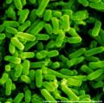
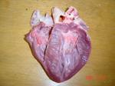
How can we use genetically engineering to help us?
By inserting a gene for human insulin into an E.Coli bacterium, the E. coli will make lots of insulin, which scientists and doctors can collect and use.
Right now, doctors are using pig hearts for transplants but there are still rejection problems. One day soon, scientists will be able to genetically engineer pigs to grow human organs for use in transplants.

Slide 34
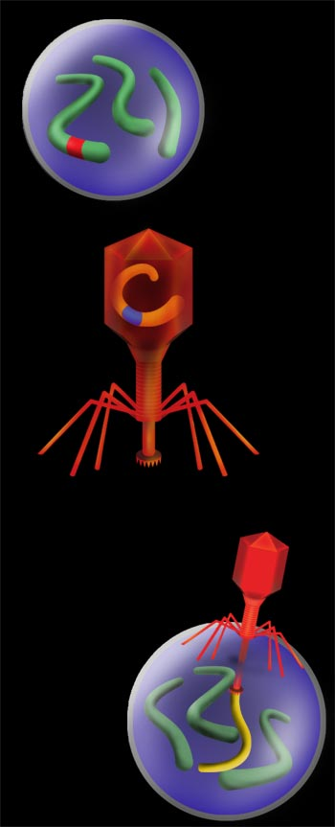
What is Gene Therapy?
In people with cystic fibrosis, one of the genes is faulty and cannot do its job properly.
To fix the problem, a copy of the same gene from a healthy person is spliced into a virus.
The patient’s lungs are infected with the virus. It delivers the working gene into the patient’s cells. The cells can then make the right protein, and the patient can breathe normally.
Patient’s cell
Patient’s DNA
Faulty Gene
Virus DNA
New working gene
Patient’s DNA
Virus DNA with new gene

Slide 35
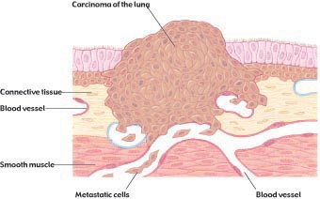
Will We Be Able To Cure Cancer With Gene Therapy?
Cancer happens when body cells grow out of control. Scientists have found a gene called p-53 which normally keeps cells under control. They think that in some people with cancer, the disease begins because the p-53 gene doesn’t work properly – perhaps because of a mistake in the gene code. Experts are now looking for a way to cure cancer by modifying faulty DNA to make the p-53 gene work.
Lung cancer cells (530x). These cells are from a tumor located in the alveolus (air sac) of a lung.

